Slide 1
Title IX
Faculty & Staff Annual Training

Slide 2
What is Title IX?
The law

Slide 3
Title IX of the Education Amendments of 1972
Federal law prohibiting discrimination on the basis of sex in federally funded programs.
“No person in the United States shall, on the basis of sex, be excluded from participation in, be denied the benefits of, or be subjected to discrimination under any education program or activity receiving Federal financial assistance.”

Slide 4
Title IX Team
Tricia Fox- Title IX Coordinator
Ellen Boushell- Investigator
Carolyne Wilhelm- Facilitator
Lashauna Gordon- Decision Maker
Jason Garber- Appeal Officer

Slide 5
Sexual Harassment/Discrimination
Sexual Harassment, discrimination, and retaliation are contrary to the values of Methodist College, and it is the policy of the College to provide a workplace and learning environment free from unlawful and improper harassment by management, employees, students or any other third parties. Preventing sexual harassment, discrimination, and retaliation, as well as other disrespectful conduct, is the responsibility of all members of the Methodist College community.

Slide 6
Title IX Protections
Protections from Discrimination on the basis of sex
Protections from Harassment on the basis of sex
Access to course offerings
Athletics and extracurricular activities
Employment and Hiring
Discipline
Facilities
Financial assistance
Treatment of pregnancy and parenting students
Recruitment, Admissions, and counseling
Dating violence
Domestic Violence
Hostile Environment
Quid pro quo
Retaliation
Sexual Assault, which includes rape, fondling, sodomy, incest, sexual assault with an object, and statutory rape
Stalking

Slide 7
Who is protected under Title IX?
Students
Employees
Prospective Students
Applicants for employment

Slide 8
Where are they protected?
On school grounds
On school sponsored trips
On MC & Carle networks, technology, and equipment
Outside of MC or Carle programs and activities if conduct is contributing to a hostile environment at MC or Carle

Slide 9




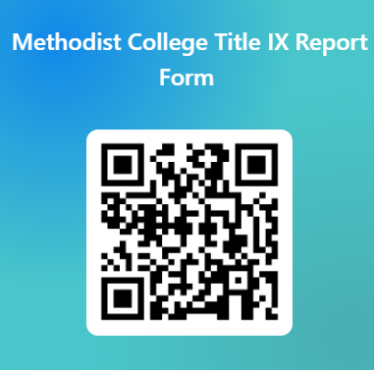
How to Submit a Formal Title IX Complaint
In person by visiting the Title IX office in W182
Online via the Title IX webpage on the MC website: Reporting Options
By phone by calling 309-672-5957
Carle Health Employees may also contact the Carle Health Regional Compliance Officer at (309) 672-4865.
By scanning the QR code and filling out the online form

Slide 10
Reporting Anonymously
Students
Faculty/Staff
Students may report a Formal Title IX complaint anonymously.
However, keep in mind that it may be more difficult to follow up with an anonymous complaint, as there may be more information needed that the complainant (who is unknown) could not answer to.
Please note that faculty and staff (as mandated reporters) must include their name in the formal report, as they cannot report anonymously.
Confidential employees such as mental health staff and counselors and HR personnel for employees are not mandated to report in a way that identifies those involved. However, they must provide information about Title IX such as contact information for the Coordinator, information about how to file, and supportive measures to those involved

Slide 11

Responding to a Title IX Disclosure
Offer Verbal Support to complainant
Inform complainant of a mandatory reporting obligation if applicable
Provide complainant with the Title IX Coordinator contact information & website information
Notify the Title IX Coordinator yourself

Slide 12

Next Steps & Supportive Measures
The Title IX Coordinator will meet with Complainant upon receipt of a complaint to:
• Offers supportive measures
• Notify of complaint process which may include an investigation and/or hearing
• Notify of informal resolution options, if applicable
• Gives option to file police report when applicable

Slide 13
Supportive Measures
Students & Employees | Employees | Students
Safety Planning | Altering work arrangements | Academic support
Notification of medical services on campus or in the community | Department transfers | Extension of deadlines, tutoring, alternative course completion options
Increased security and monitoring of certain areas | Reallocation of tasks | Transfer sections or class schedule modifications
Escorts if needed | Regular check-ins | Access to counselling services via MC Counselor
Leaves of absence | Employee Assistance Program | Offer to designate an advisor through all steps of the process

Slide 14
Pregnancy & Related Conditions

Slide 15
Pregnancy and Related Conditions
Pregnancy and related condition includes pregnancy, childbirth, termination of pregnancy, & lactation; related medical conditions and recovery therefrom
• Students who are pregnant or have related conditions are eligible for reasonable modifications, upon request
• Students are not required to share their pregnancy with faculty, but in sharing the student can be offered reasonable modifications
• Pregnancy and related condition modifications cannot be granted retroactively
• Students must be self advocates and be proactive in reporting and in communication with faculty

Slide 16
Reasonable Modification Examples
Breaks during class to express breast milk, breastfeed, or attend to health needs associated with pregnancy or related conditions, including eating, drinking, or using the restroom
Intermittent absences to attend medical appointments
Changes in schedule
Time extensions for coursework and rescheduling of tests and examinations
Allowing a student to sit or stand, or carry or keep water nearby
Changes in physical space or supplies (for example, access to a larger desk or a footrest)
A larger uniform or other required clothing or equipment
Leave of absence
Implementing incomplete grades for classes that will be resumed at a future date

Slide 17
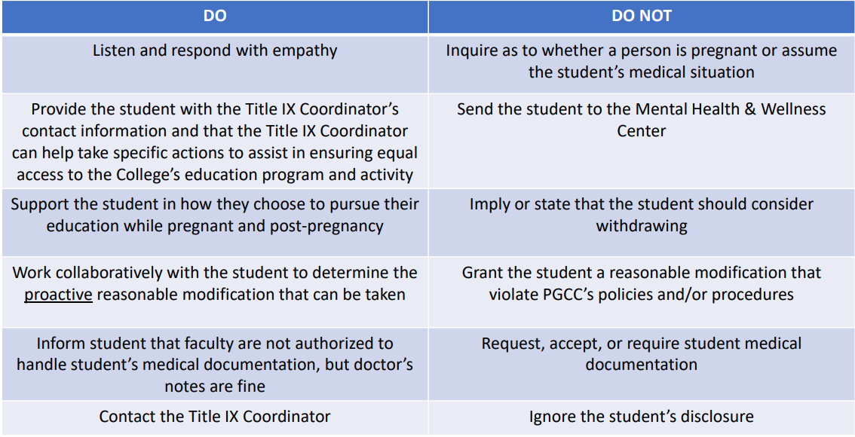
Pregnancy and Related Conditions: Employee Response
MC

Slide 18
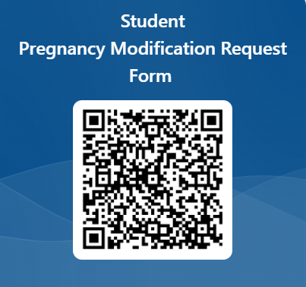
How to file for Pregnancy Modifications
Students can contact the Title IX coordinator via:
e-mail at tfox@methodistcol.edu
or phone at (309) 672-5957
Or by filling out the online form methodistcol.edu/current-students/student-support-services/title-ix/title-ix-pregnancy-modififications

Slide 19
Next Steps & Supportive Measures
The Title IX Coordinator will meet with the student upon receipt of Pregnancy or related condition form or referral to:
• Work with student and their physician to determine needs/modifications
• Notify faculty of modifications via official modification letter
• Work with Deans and Faculty as necessary to ensure equal access
• Provide all options including withdraw and/or leave of absence

Slide 20
Always remember… The MC Title IX policy is available online as a resource & includes more detailed information on definitions, processes, and grievance procedures. TitleIX.24.pdf

Slide 21
Thank You for your attention to our annual Title IX training. Questions? Please email tfox@methodistcol.edu

